Slide 2
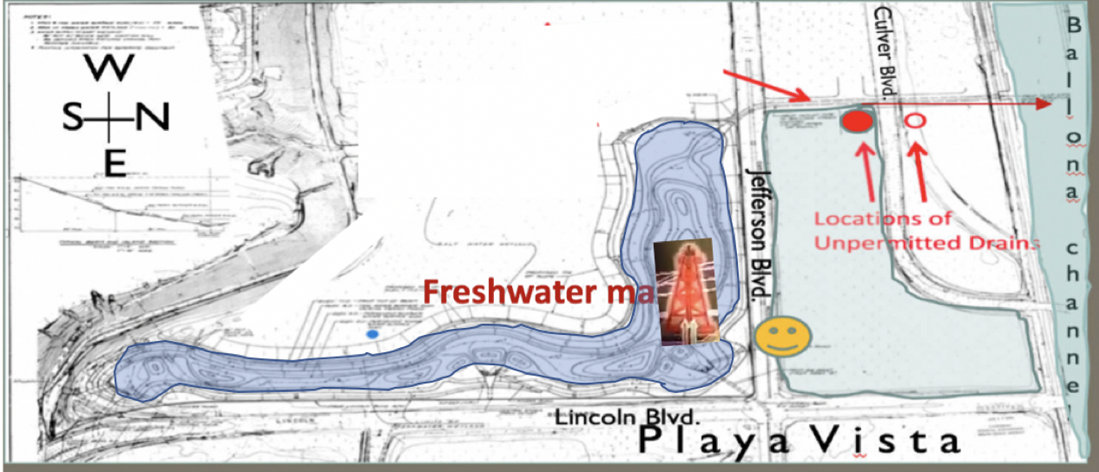
The Drains are connected to the Main Drain (outflows to Ballona Channel from the marsh—seen below as long red arrows)

Slide 6
University City Syndicate Leaking,
Out Gasing Well Reabandoned
In 2001 in the Freshwater Marsh,
Playa del Rey, California.
Location on Jefferson and Lincoln.

Slide 8
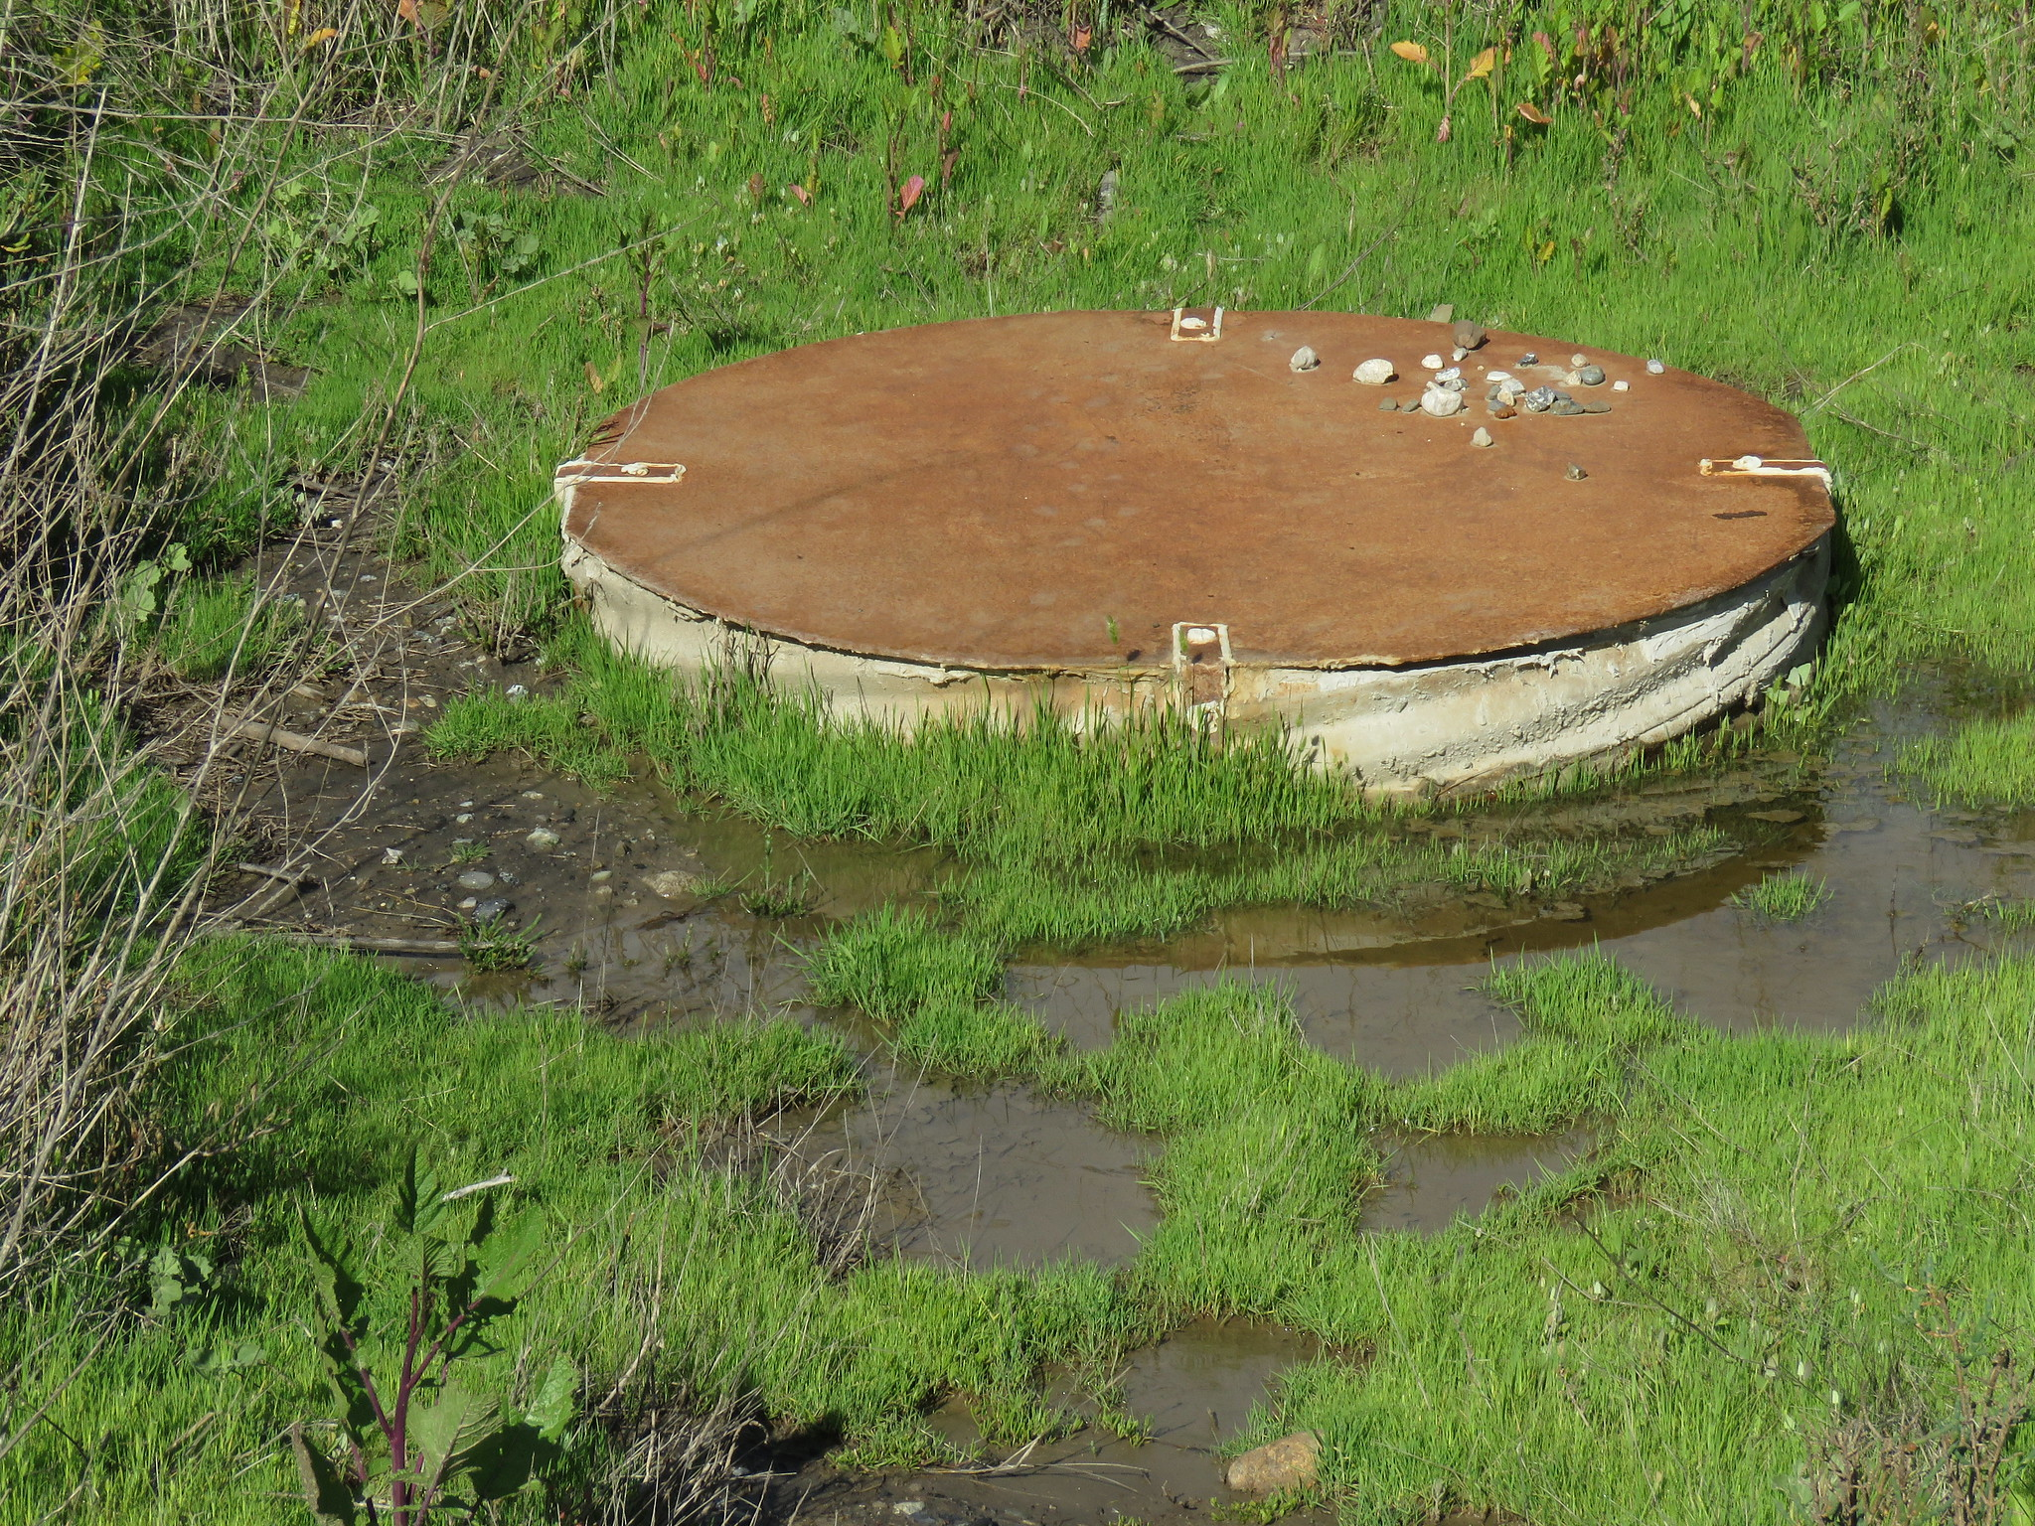

Slide 9
